Slide 1

Wolt Assignment 2 Data Analysis
S M Rifaiya Abrar

Slide 2

Table of contents
01
02
03
04
Overall Usage
Summary
User Spend
Behavior
05
User
Engagement
Daily Usage
Preferred Device

Slide 3
Some of the Key Metrics to Track
Key Findings:
Customer Conversion Rate:
Measures the percentage of registered users who make at least one purchase.
Helps evaluate the effectiveness of onboarding and marketing efforts in converting users into paying customers.
Retention Rate:
Percentage of active users who make repeat purchases (In this case > 1)
Indicates customer loyalty and satisfaction with the service. High retention rates lead to long-term revenue growth. Can increase the threshold to measure retention, also measure by weekly or monthly which couldn’t be possible here as all the registration of users have been in one single month.
Average Order Value (AOV):
Tracks the average revenue generated per purchase and per country.
A key indicator of customer spending behavior and profitability. Higher AOV suggests opportunities to upsell or cross-sell.
Device-Specific Activity:
Tracks user activity and purchase behavior across devices (iOS, Android, Web).
Identifies platform-specific issues or opportunities for optimization (e.g., improving Android app performance if Android users are less active).
Low Conversion in Some Countries: Many countries show high registration but low conversion rates. Campaigns, offers, and improved onboarding can help activate these users.
Restaurant Dominance: Restaurants account for the majority of purchases across all countries, making them a critical revenue driver.
American Cuisine Preferred: 39.53% users prefer American Cuisine as their top restaurant type.
Geographic Patterns: Denmark has higher customer conversion rates and AOV compared to Finland (and others), which struggles with activation despite high registrations. Greece also struggles with activation and experiences high churn after one purchase.
Device Insights: Android users are more likely to be inactive compared to iOS users, especially in Finland where over 50% of Android users are inactive. Improving the Android app experience is crucial.
Missing Data : Late Night Purchase data is missing in the dataset which contradicts with most common hour of purchase. Causes can be from inputting data to other errors. Handled by engineering data using most common hour of purchase data.

Slide 4
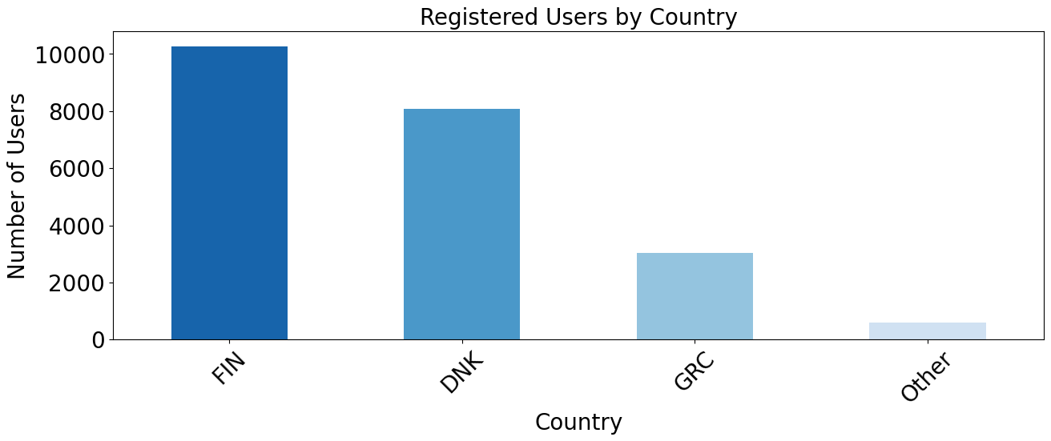
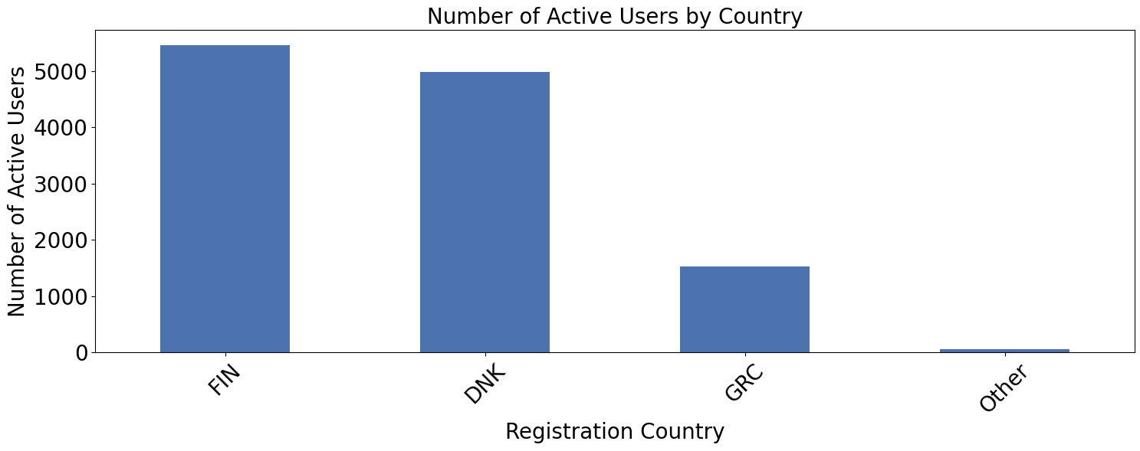
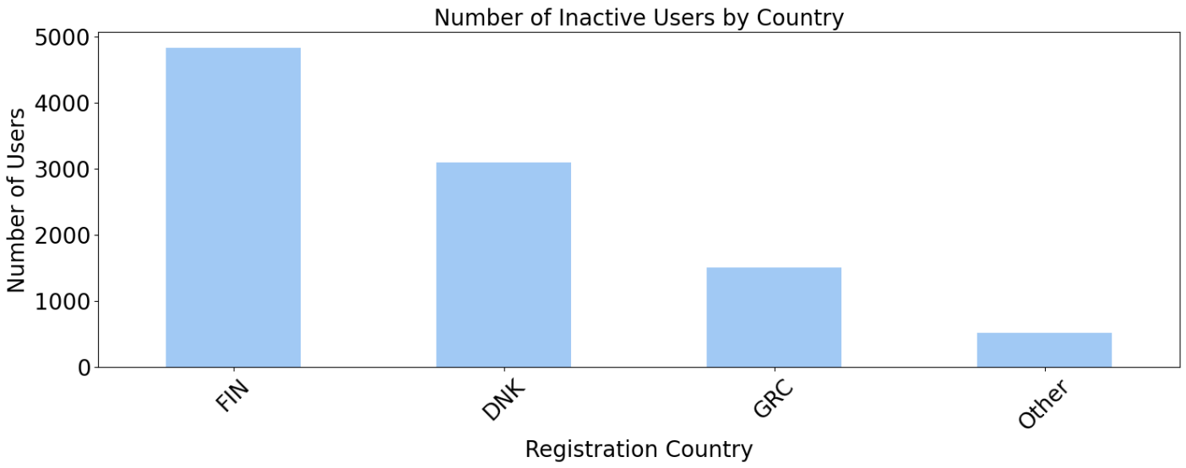
54.72% Customer Conversion Rate
Overall Usage Summary
65.26% Customer Retention Rate
Simplified Country | Active Users | Active Rate % | Retained Rate % | Churned Rate %
Denmark | 4985 | 61.84 | 65.49 | 34.50
Finland | 5450 | 53.20 | 65.72 | 34.27
Greece | 1532 | 50.53 | 62.53 | 37.47
Others | 60 | 10.45 | 73.33 | 26.67
34.74% Customer Churn Rate
Note: Retention Rate = Users with purchase count >1 Churn rate = Users with purchase count ==1
Table: User Activity Table
Insights and Recommendation:
Zero Conversion Countries: Many countries have zero conversion rate. Identifying and addressing why these countries show zero purchase conversion can increase revenue.
Untapped Potential: Target countries with high registration but low conversion; offer targeted campaigns and incentives.
Finland’s Challenge: Finland has high registration but equal active/inactive users indicates there is a problem with onboarding or value proposition. Need user research and tailored interventions.
Denmark's Success: Higher active users. Investigate and apply Denmark’s strategies (marketing, localization) to other markets.

Slide 5
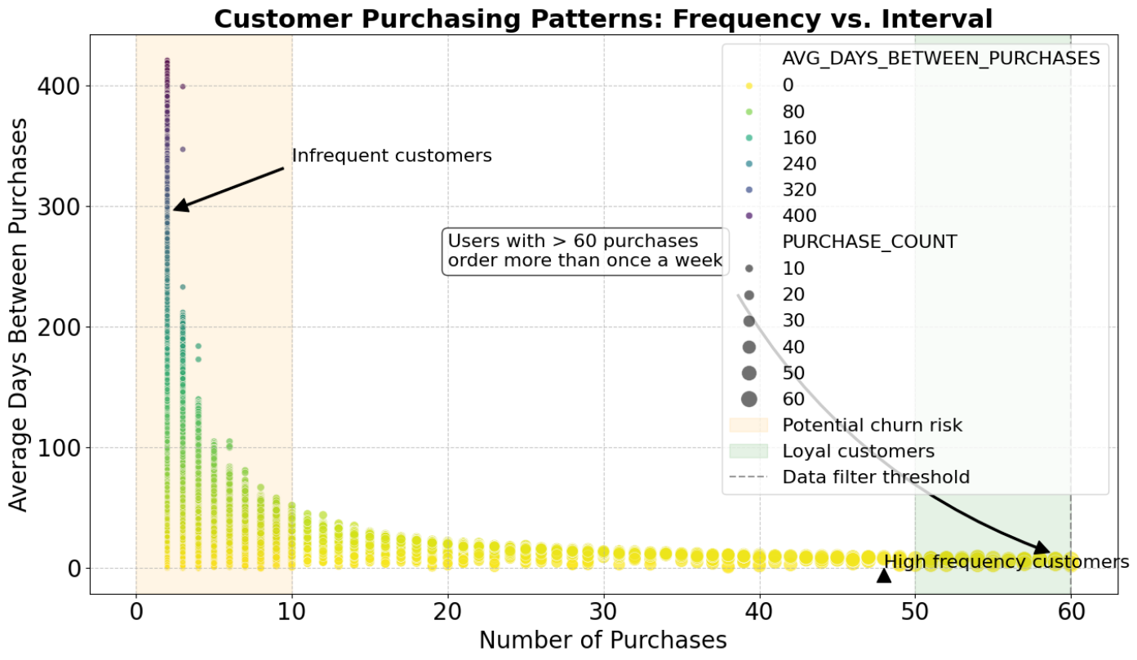
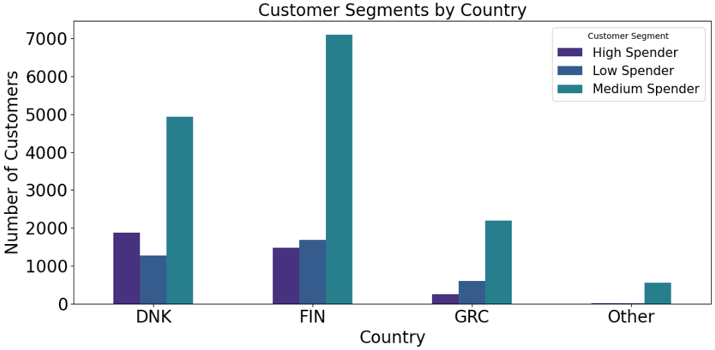
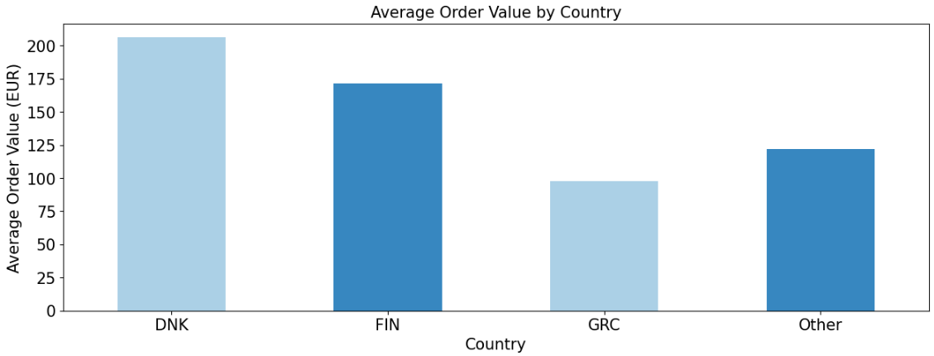
User Spend Behavior
Insights and Recommendation:
High Potential Customers: As the number of purchases from a specific customer increases, the average days between purchases decrease. Users with >60 purchases orders more than once a week.
Addressing Customer Churn: The customer base tends to churn immediately after one purchase.
DNK & FIN Drive Revenue: Denmark (DNK) and Finland (FIN) have significantly higher Average Order Values (AOV) , highlighting their importance to overall revenue.
Total Spending Dominance : Denmark has the highest total Euro spend which is much greater than Finland with much less registered users.
Luxury Spending Nation: Denmark has the highest spenders (51.9%) among other countries while Finland has the most Medium spenders (48.1%) among others which is 69% of her own users suggesting heavy medium spenders.
Country | Denmark | Finland | Greece | Others
Euro € | 1028537.1 | 933584.2 | 150036.1 | 150036.1
Table: Total Euro Spend by Country
 | High Spenders | Medium Spenders | Low Spenders
Total Users | 3609 | 14786 | 3588
Denmark | 51.9% | 33.4% | 35.6%
Finland | 40.9% | 48.1% | 47.1%
Greece | 6.8% | 14.8% | 16.9%
Others | 0.4% | 3.7% | 0.4%
Note: Users has been segmented into three groups, high, medium and low spenders with >70 high and <30 is low.
Table: Spenders Percentile of Each Segment by Country

Slide 6
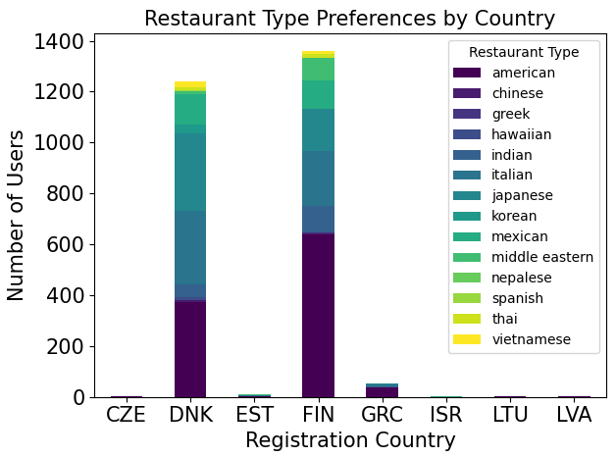
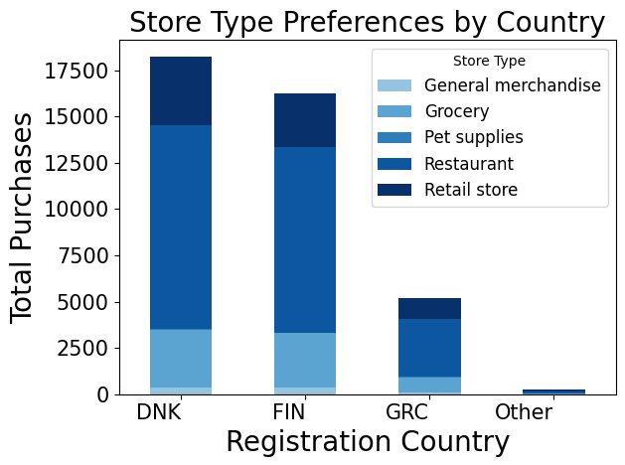
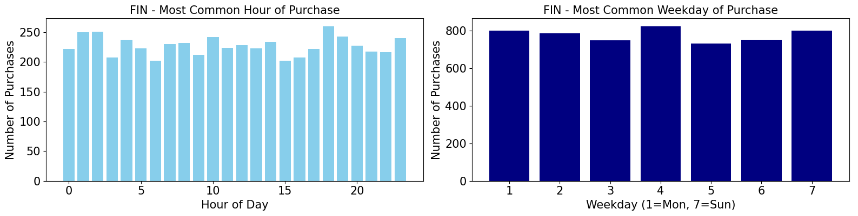
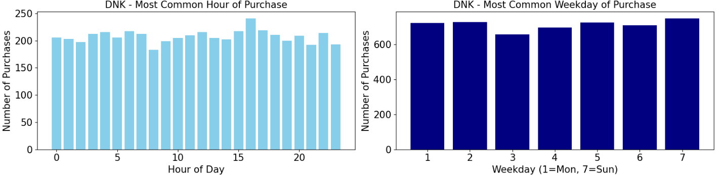
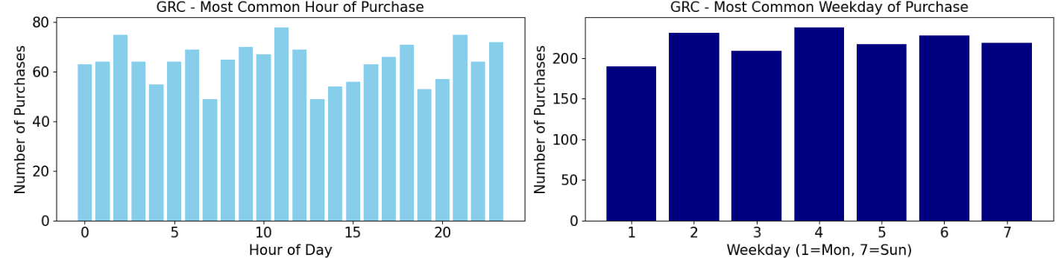
User Engagement
39.53% Top Votes Preferring
American Restaurant
Note: Voters are mainly from Finland and Denmark.
Insights and Recommendation:
Enhance Restaurant Offerings: American cuisine is the topmost preferred ( First Choice ), receiving 1,054 votes, followed by Italian (517) and Japanese (476). Collaborating with these popular cuisines while promoting less-preferred cuisines with discounts or offers can increase more revenue.
Store Type Preferences: Restaurants dominate across countries, followed by grocery and retail stores. Increasing collaboration with more restaurants and promoting other store types can attract more customers.
Optimize Time-Based Campaigns: Leveraging the peak purchase hours and days for targeted promotions and allocating riders can multiply purchases.
Restaurant Type | Top Preferred Votes
American | 1054
Italian | 517
Japanese | 476
Mexican | 233
Indian | 158
Middle East | 101
Vietnamese | 36
Korean | 33
Thai | 27
Chinese | 13
Hawaiian | 11
Greek | 5
Nepalese | 1
Spanish | 1
Finland
Denmark
Greece
Most Common Hour and Weekday of Purchase
Table: Preferred Restaurant

Slide 7
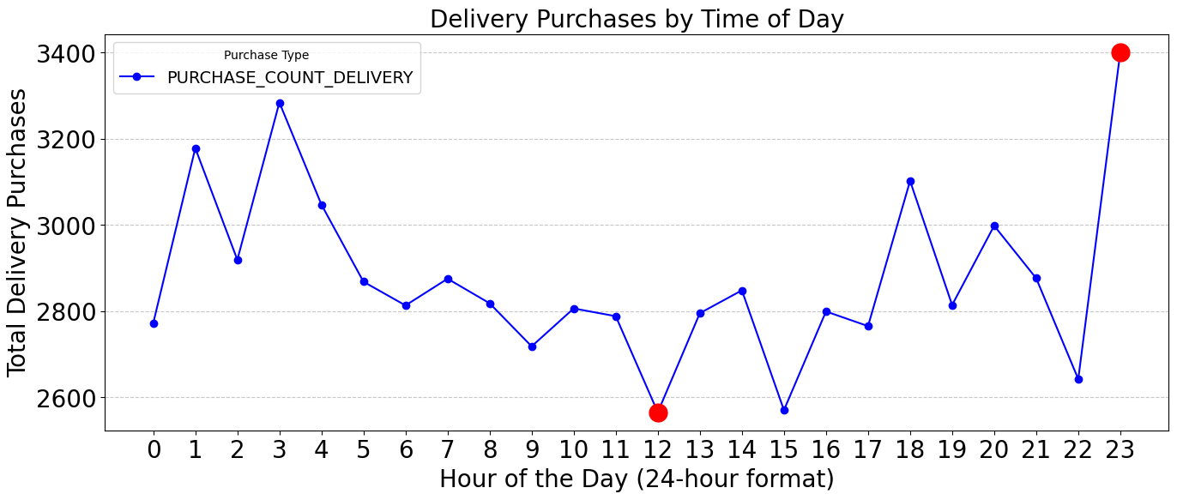
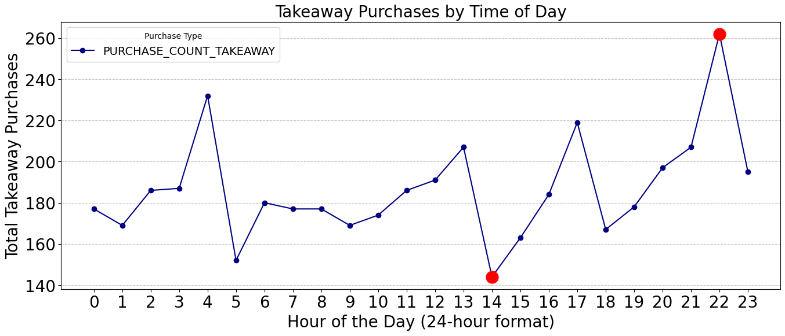
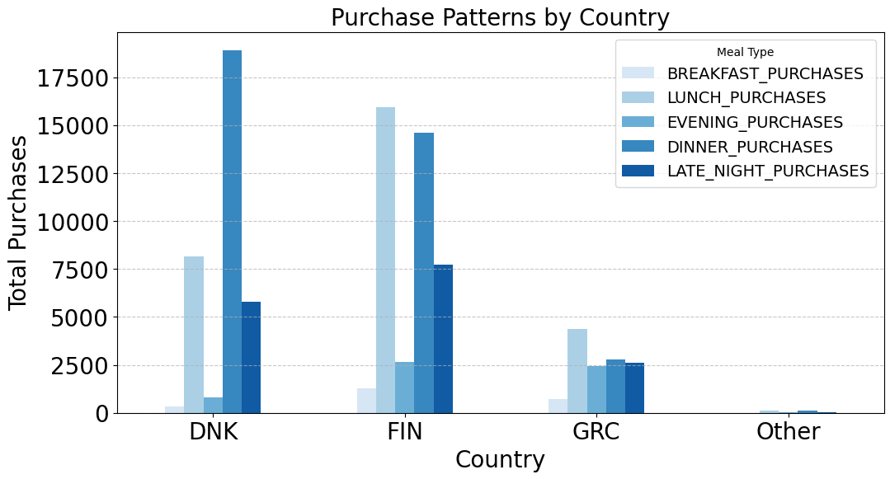
Daily Usage Dashboard
Country | Delivery Purchases | Takeway Purchases | Delivery Ratio
Denmark | 25996 | 2226 | 92.11%
Finland | 32569 | 2065 | 94.04%
Greece | 10218 | 162 | 98.44%
Others | 278 | 27 | 91.15%
Table: Delivery & Takeway by Country
Insights and Recommendation:
Mealtime Purchases: Dinner accounts for the highest percentage of purchases (40.7%), followed by lunch (31.9%). Evening purchases are minimal (6.5%), indicating potential for targeted promotions during off-peak hours.
Delivery Dominance: Delivery purchases dominate across all countries, This suggests strong demand for delivery services. Having more delivery persons can always ensure customer satisfaction.
Time-Based Purchase Trends: Delivery purchases notably change from, 22:00-23:00, suggesting peak time for delivery demands. with takeaway purchases increase right before then. Can collaborate and strategize with stores accordingly to increase profit.
Country Patterns: Although very similar, Finland tends to purchase more in lunch hours. On the other hand Denmark dominates in Dinner orders suggesting key areas to look for.
Note: Late night purchase data has been engineered based on the most common purchase hours.

Slide 8
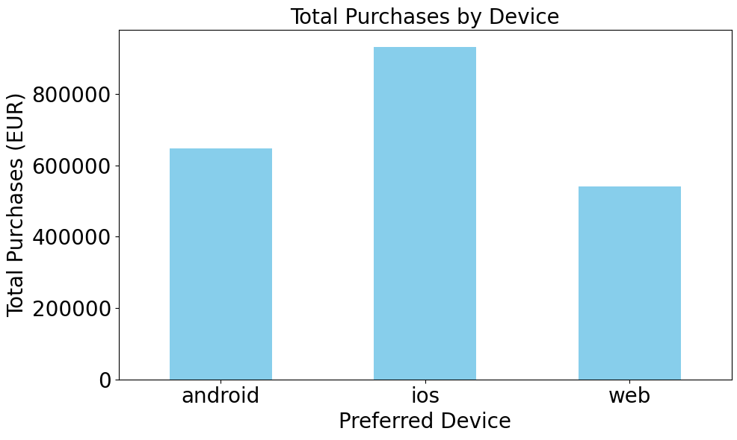
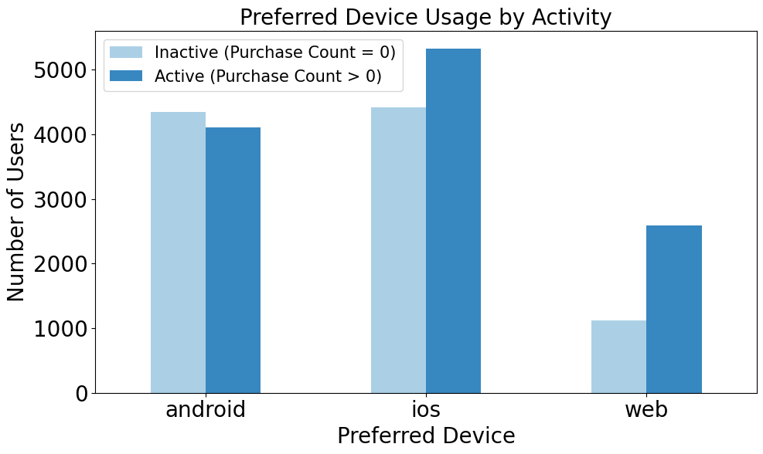
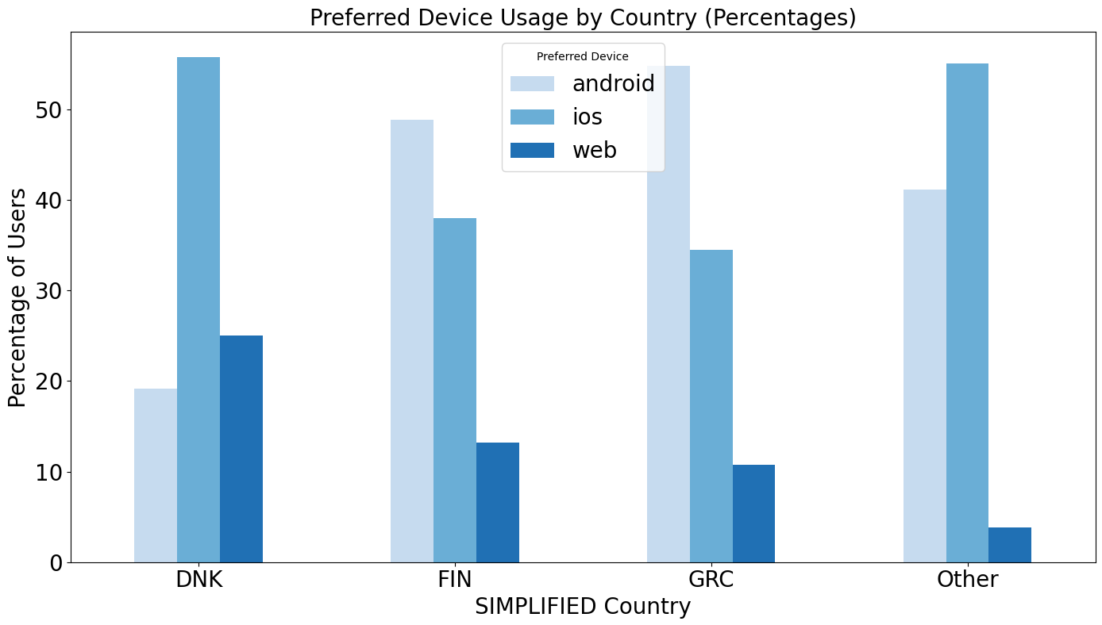
Insights and Recommendation:
Android Improvement: Finland has the most Wolt users in which 49% are android users, from which more than half of the android users are inactive. If we get customer feedback data, improving android app experience accordingly could boost engagement and purchases, as Android has more inactive users than active users.
IOS Experience: Denmark has the highest IOS device users who generates the most revenue. Using Denmark’s strategy in low-conversion countries, where IOS preference is high (54.9%) may help increase conversions.
Web Platform: High-conversion countries have more web users (17.3%) vs. low-conversion ones (3.8%). Enhancing the web platform could attract more users globally.
Preferred Device Stats
Country | Active IOS Rate % | Active Android Rate % | Active Web Rate %
Denmark | 59.89 | 53.39 | 72.67
Finland | 53.08 | 49.66 | 66.69
Greece | 51.34 | 46.78 | 67.08
Others | 10.76 | 8.47 | 27.27
IOS
Android
Web

Slide 9

Final Takeaways and Potential Opportunities
Denmark’s Success Story: Despite fewer users than Finland, Denmark generates significantly higher revenue. Factors contributing to this could be the majority number of IOS users who enjoys a better-optimized iOS experience, higher AOV, and strong engagement during dinner hours (possibly because of more night life/parties). Targeting night life area’s and replicating Denmark’s strategy in underperforming regions may unlock growth.
User Journey & Funnel Data: Collecting information on where exactly users drop off during registration or ordering can be ideal for understanding low conversion in countries with high registration. Surveys can also help understanding the problems to tackle churns as well.
Android Engagement Gap: In Finland and Greece, majority are android users and most of them remain inactive. This indicates potential issues in app usability or onboarding. User feedback on the Android experience is essential to diagnose and resolve this.
Segmented Spending Behavior: Denmark leads in high spenders, while Finland has a strong medium spender base. These insights can guide loyalty programs and tier-based incentives.
Cuisine Preferences Matter: Preferred restaurant is a valuable metric to analysis. Collecting this data from other countries other than Denmark and Finland can be crucial to identify pattern. Getting data like purchase counts or amount of euro spend in every type of cuisine can bring out more potential trend analysis that can help boost revenue. Given data says American cuisine is the top choice, followed by Italian and Japanese. Partnering with popular restaurants and strategically promoting less-popular cuisines (through offers or bundle deals) could balance customer preference and restaurant demand.
Restaurant Ratings & Reviews: Potential analysis can be done by linking preferred restaurants with quality metrics and franchises which could explain popularity trends or churn reasons.
Potential Anomaly: Restaurants consistently appear as the most frequent store type for purchases. In every case where the purchase count is highest by store type, restaurants either lead or tie with other types. This uniform dominance may indicate a potential anomaly or inconsistency in the dataset, warranting further validation of store-type classification or data collection methods.

Slide 10
Thank You!

